Slide 1

Colorado West Healthcare Workforce Insights Dashboard
BADM 550 Class Presentation

Slide 2

Agenda
Business Problem
Optimizing Workforce with People Analytics
Analytics Problem
Main Objectives
Data Overview
Process and Insights
Dashboard Overview

Slide 3

BUSINESS PROBLEM
Colorado West Healthcare faces challenges in optimizing its workforce management and understanding the dynamics of employee productivity, turnover, and salary distribution across departments.
The organization lacks a comprehensive system to:
Identify and address high turnover rates by job family or department.
Analyze productivity trends to improve operational efficiency.
Ensure fair and competitive salary distribution to enhance employee satisfaction and retention.

Slide 4
OVERVIEW OF PEOPLE ANALYTICS
A data-driven approach to understanding and optimizing workforce performance.
Enables strategic decisions on productivity, turnover, hiring, and salary allocation.
Key Applications in This Project-
Workforce Productivity Analysis:
Measure employee efficiency across departments using Productivity % metrics.
Identify high-performing departments or areas needing improvement.
Turnover Trends:
Analyze termination reasons using Termination Reason Categories.
Monitor turnover rates to address key areas of attrition.
Hiring Patterns:
Track trends in employee hiring and compare them with termination rates.
Ensure adequate staffing and align hiring with organizational needs.
Salary Insights:
Visualize annual salary distribution across departments.
Support equitable and strategic resource allocation.
Strategic Workforce Planning:
Combine productivity and turnover insights to align workforce strategies with organizational goals.

Slide 5
ANALYTICS PROBLEM
PROBLEM
Lack of consolidated insights into workforce performance, turnover, and salary distribution.
Difficulty in identifying trends across job families and departments for strategic decision-making.
OBJECTIVES
Provide actionable insights into employee productivity, turnover rates, and salary distribution.
Develop a dynamic and user-friendly workforce analytics dashboard.
Facilitate data-driven decisions to optimize workforce management and planning.

Slide 6

MAIN OBJECTIVES
Create impactful visualizations to analyze workforce productivity, turnover, and compensation.
Implement calculated metrics for job family productivity and retention analysis.
Deliver data-driven insights to optimize HR and operational strategies.

Slide 7
DATA OVERVIEW
DATA SOURCE
Primary Source: Employee data from UKG system.
Key Tables: Employee Information, Job History, Health Care Eligibility Periods.
Supplementary Fields: Charge Date and Scheduled Hours (subject to confirmation).
FIELDS UTILIZED FOR THE DASHBOARD
Employee Information:
Employee Number, Job Family, Job Family Category.
Last Hire Date, Termination Date, Start Date (History).
Annual Salary, Hourly Pay Rate.
Calculated Fields:
Monthly Productivity %, Turnover Rate %.
Hired vs Terminated counts.
Job Family Productivity, Termination Reason Category.

Slide 8
Process and Insights
Process:
Extracted and prepared data from UKG, focusing on employee and job details.
Built dashboards in IBM Cognos with calculated metrics for productivity and turnover.
Validated data and metrics for accuracy.
Insights:
Identified productivity trends across job families.
Highlighted turnover patterns for targeted retention strategies.
Analyzed salary distribution for equitable reviews.
Monitored hiring and termination trends for workforce stability.

Slide 9
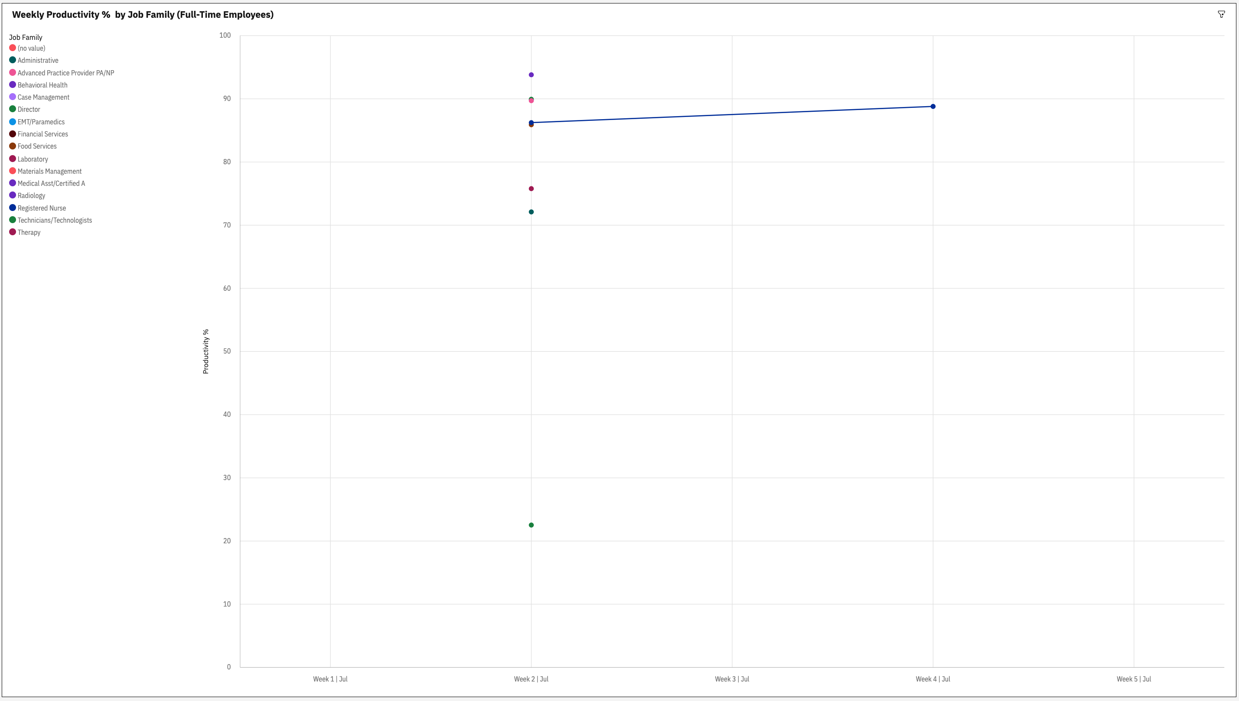
Monthly Productivity % (Full-Time)
Productivity trends reveal job family fluctuations.

Slide 10
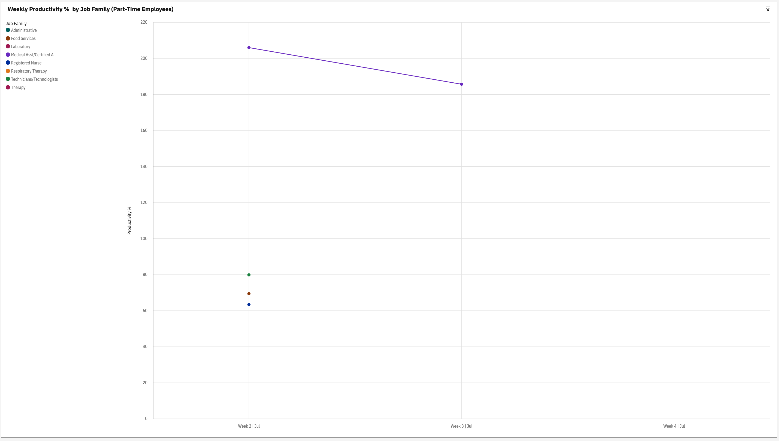
Monthly Productivity % (Part-Time)
Productivity trends reveal job family fluctuations.

Slide 11
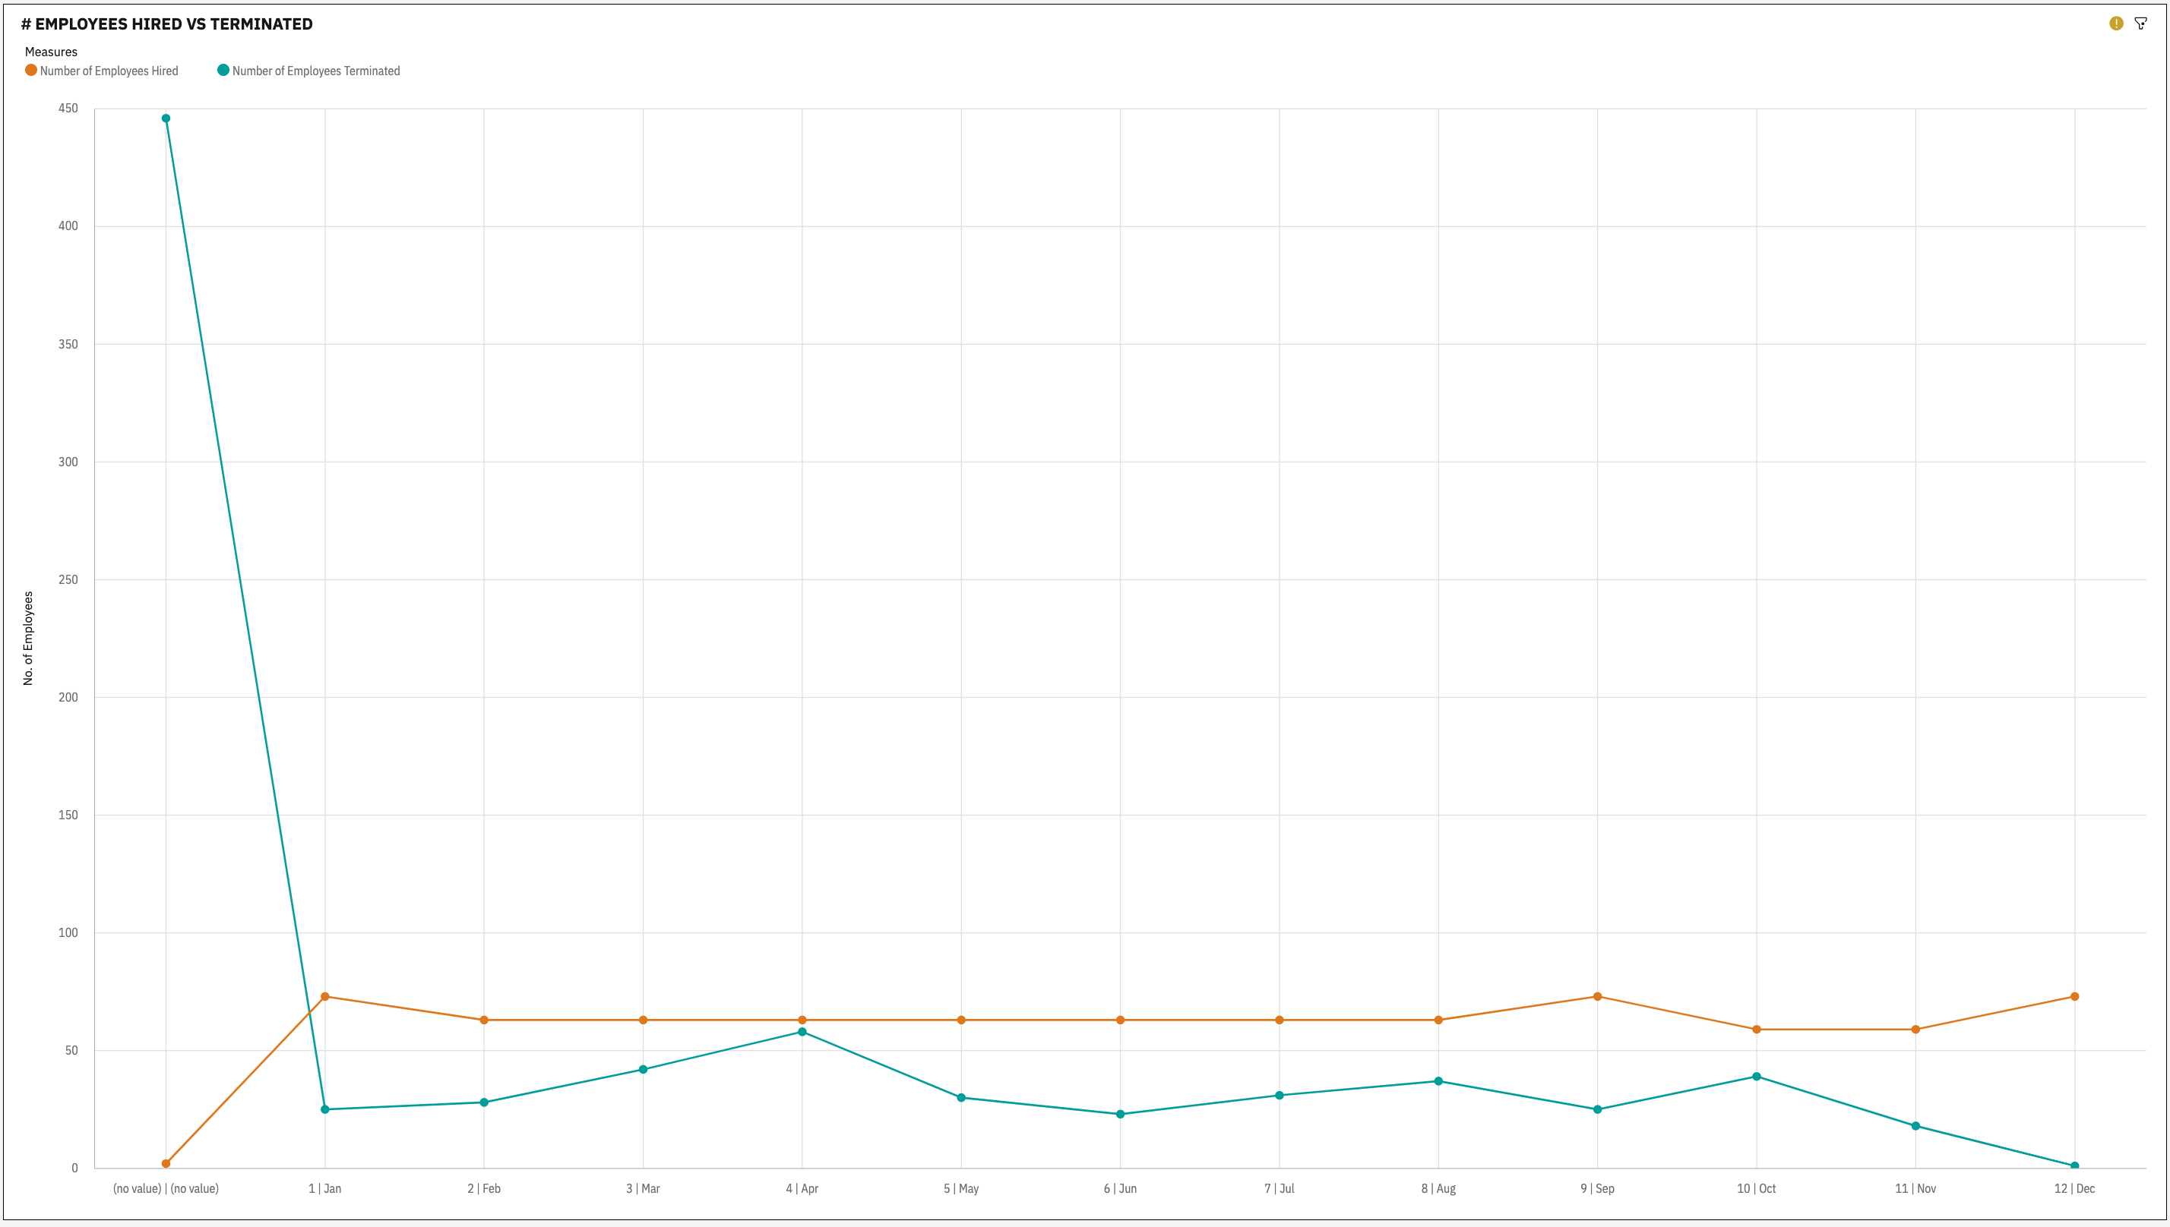
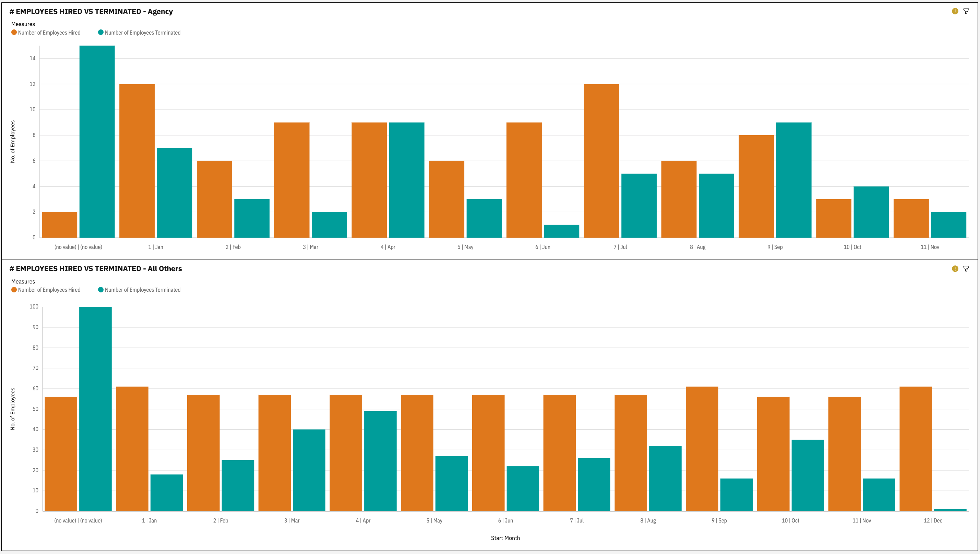
Employees Hired vs Terminated
Yearly trends highlight workforce adjustments.

Slide 12
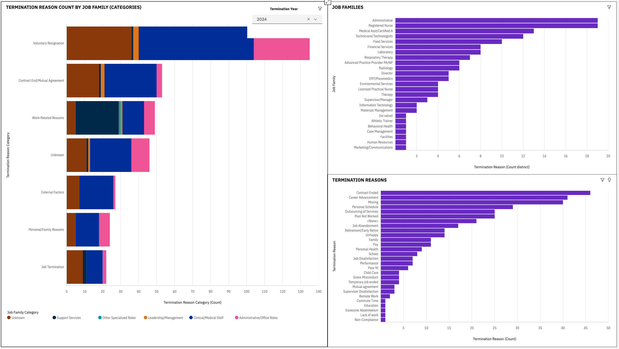
Termination Reasons by Job Family
Categorized reasons for turnover across roles.

Slide 13
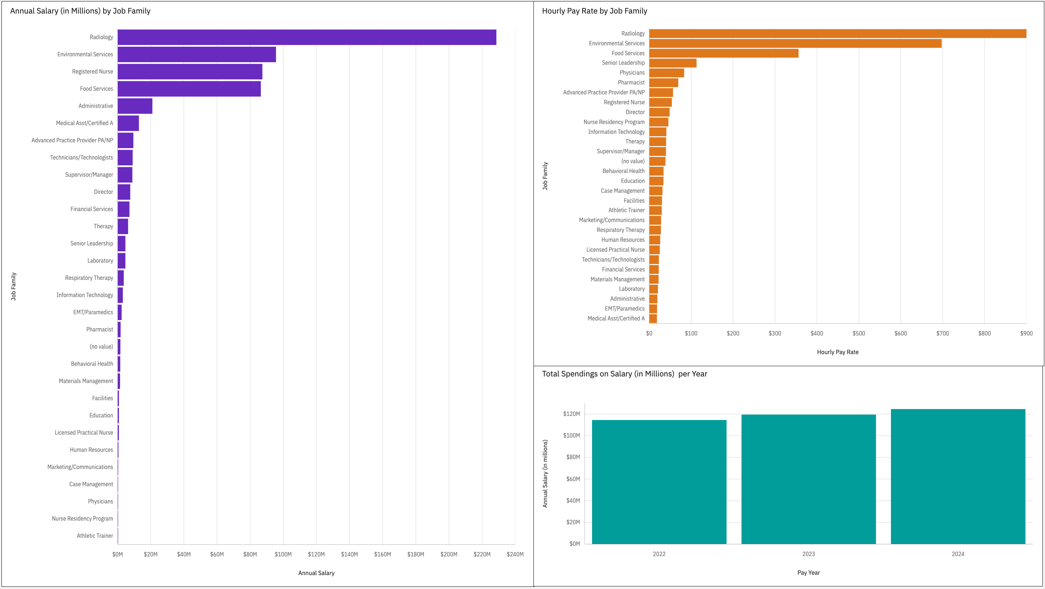
Salary Insights by Job Family
Salary trends and distribution patterns identified.

Slide 14
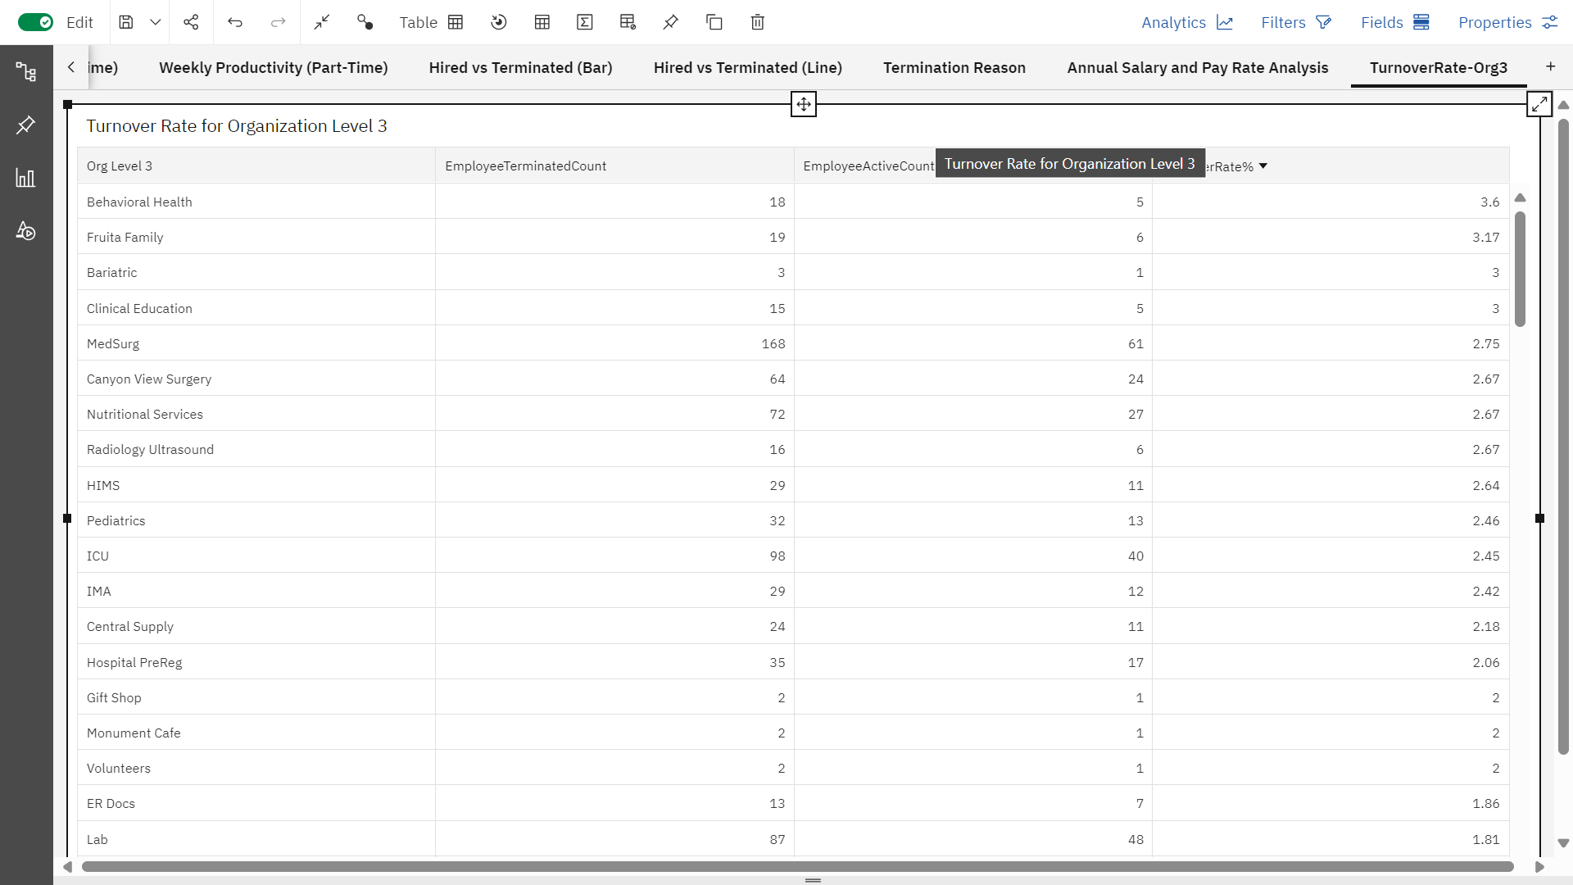
Turnover Rate

Slide 15
Next Steps and Q&A
Next Steps
Focus on improving the accuracy of the existing data.
Validate the current data to ensure reliability and consistency.
Address gaps and inconsistencies in current metrics.
Explore alternative methods to enhance insights without relying on additional data sources.
Questions?

Slide 16

Thank You!

